Slide 1
Preliminary Design Review
XXX Team
CCP-XXX-PDR-XXXX

Slide 2
START HERE
This is where OBC should have some sort of knowledge

Slide 3
Communications Systems
Data handling protocols
Data Downlinking Strategy
TT&C Data Volume
Payload Operation
Hardware
Radiation Pattern Analysis
Link Budget
Frequency Licensing Status

Slide 4
Communications Subsystems
EnduroSat type II transceiver data handling protocols:
Information | Transparent | AX.25
Maximum Information per payload (bytes) | 128 | 97
Minimum Information per payload (bytes) | 9 | 4
FEC correction | CRC | None
Overhead | Low | High
Standardization | No | Yes
ARQ | Yes | Yes
Notes:
ARQ = Automatic Repeat Request
FEC = Forward Error Correction

Slide 5
Communications Subsystems
For multiple ground stations and being flexible for other teams, AX.25 was chosen.
Information | Transparent | AX.25
Maximum Information per payload (bytes) | 128 | 97
Minimum Information per payload (bytes) | 9 | 4
FEC correction | CRC | None
Overhead | Low | High
Standardization | No | Yes
ARQ | Yes | Yes
Notes:
ARQ = Automatic Repeat Request
FEC = Forward Error Correction

Slide 6
Communications Systems
Operation:
Endurosat type II transceiver, Half duplex
Protocol:
AX.25
Modulo 8 implementation
7 Information frames before an acknowledge frame
Information field: 776 bits of information (84.35%)
Overhead: 144 bits (15.65%)

Slide 7
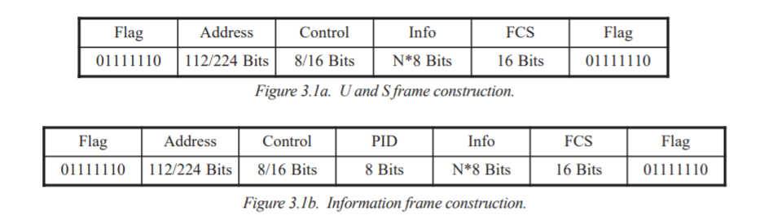
Communications Systems
Network Layer Protocol (PID):
Not implemented
Address:
Determined by callsigns
Notes:
https://www.tapr.org/pdf/AX25.2.2.pdf image taken from

Slide 8
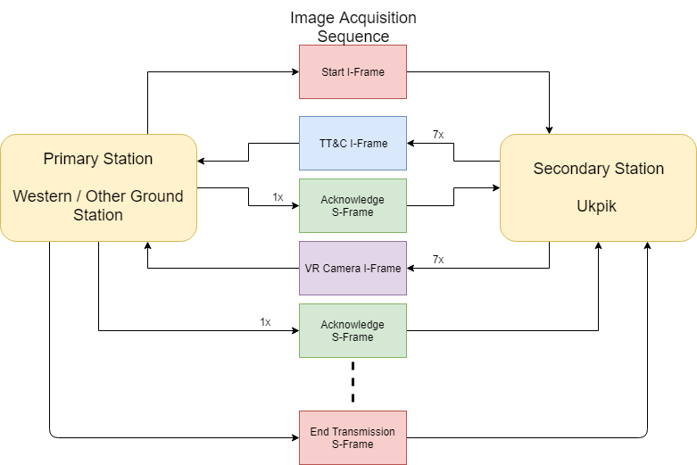
Communications Systems
Notes:
Update name to Ukpik / add title of image acquisition Communication

Slide 9
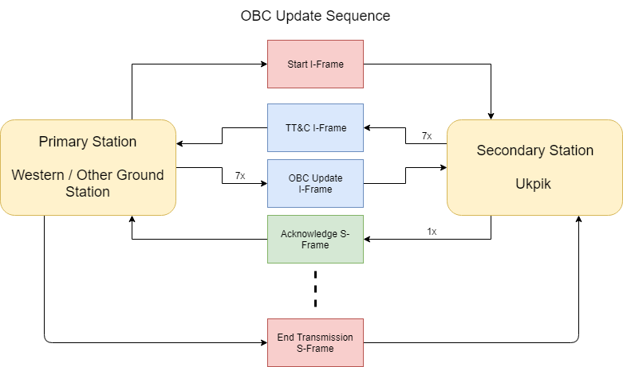
Communications Systems

Slide 10
Communications Systems
Start I-Frame:
Command for current transmission, maximum end transmission time ,Next time to transmit
Next groundstation callsign
Commands
Send image thumbnails, send specific image, apply OBC patch, capture image
Extreme case:
Built in information frame for stop all transmission IMMEDIATELY.

Slide 11
Communications Systems
TT&C I-Frame:
First packet sent back by CubeSat
Contains the following sensor information:
OBC time
GPS coordinates
Sun Sensor Voltage + Currents
Battery voltages
Temperature Sensors
Solar Panel voltages
Magnetorquer current/voltage sensor
Magnetic compass sensor
Notes:
Time permitting go and check all the data yourself
Capture rate = 1 min
Sensors per 1 reading
General data ask vidushi

Slide 12
Communications Systems
Acknowledge S-Frame (ARQ):
Acknowledge send next frame
Acknowledge do not send next frame
Selective Reject a frame for retransmission
Reject all frames, retransmit all

Slide 13
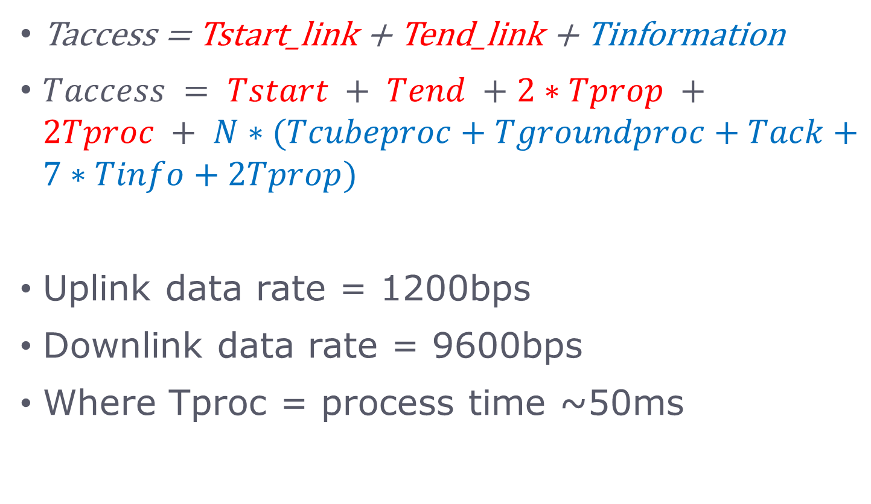
Communications Systems
Taccess = Tstart_link + Tend_link + Tinformation
$Taccess = Tstart + Tend +2∗Tprop +2Tproc + N∗(Tcubeproc+Tgroundproc+Tack+7∗Tinfo+2Tprop)$
Uplink data rate = 1200bps
Downlink data rate = 9600bps
Where Tproc = process time ~50ms

Slide 14
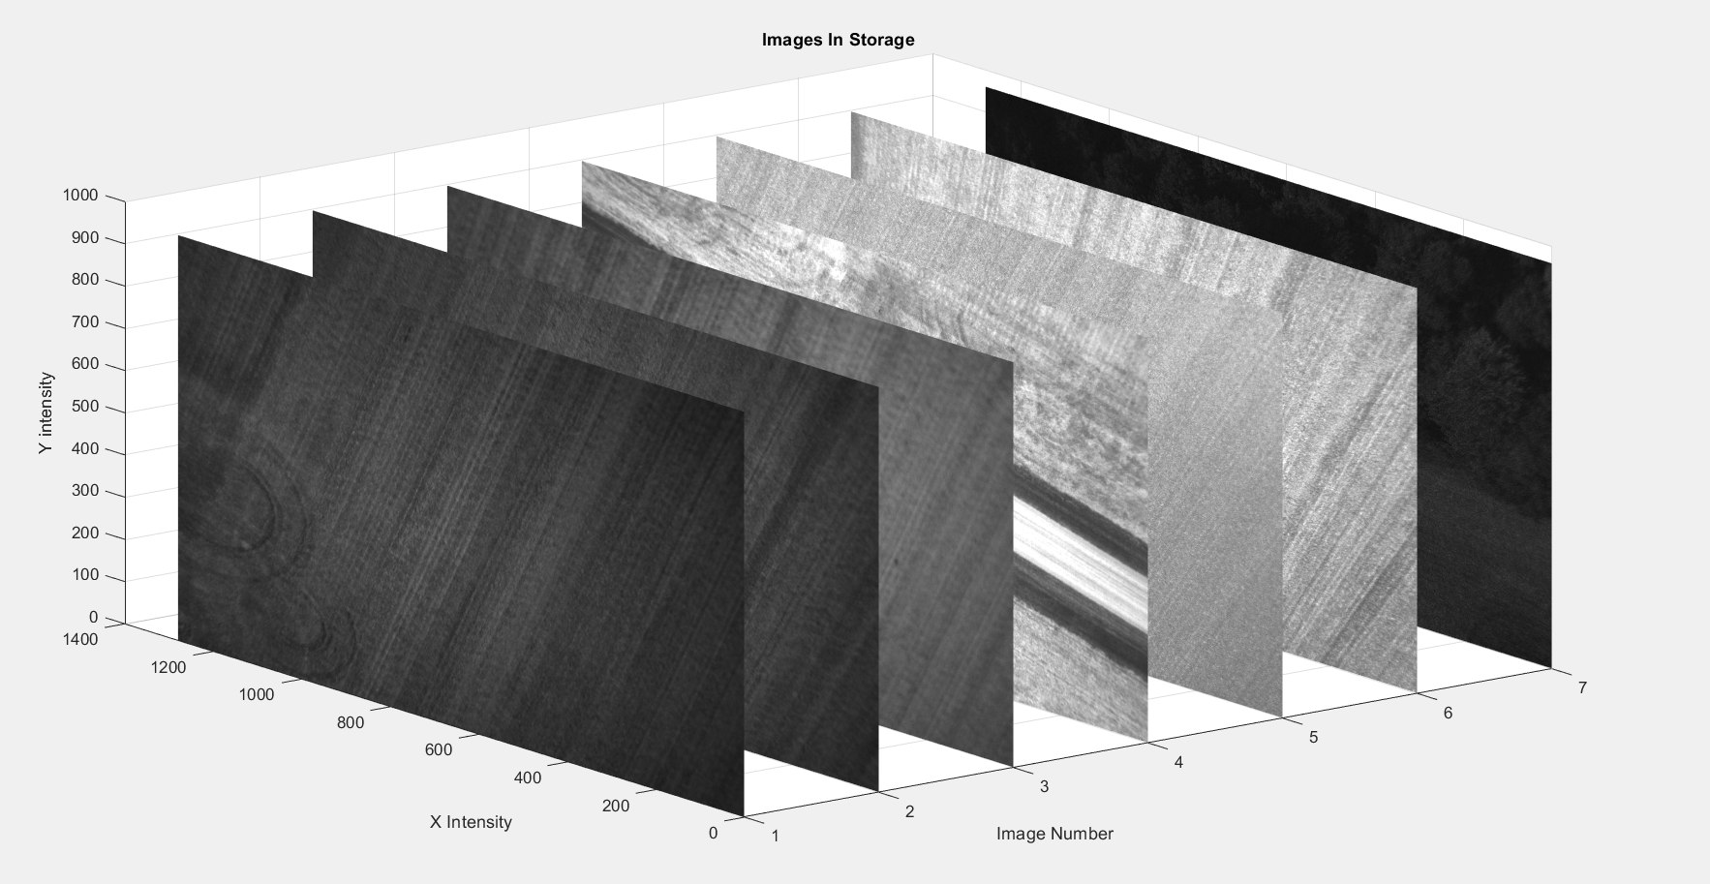
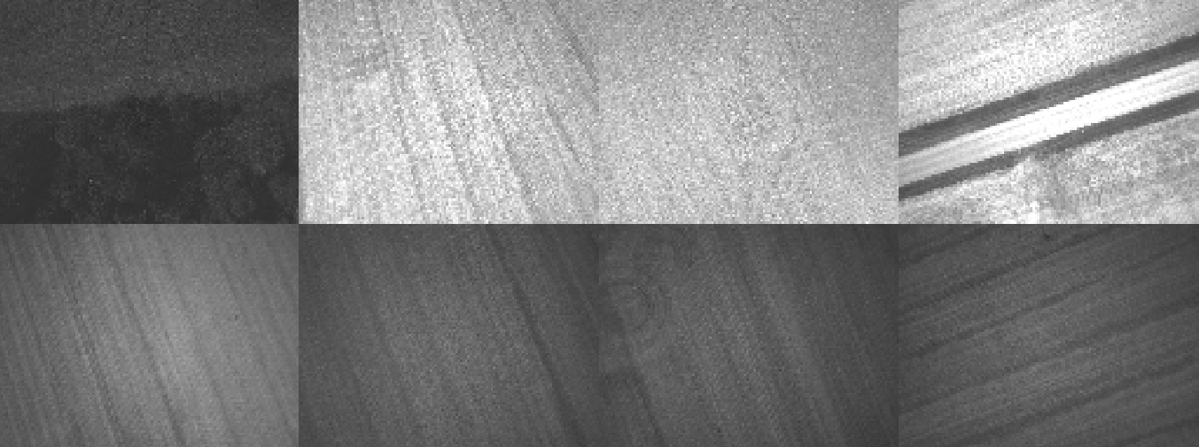
Communications Systems
VR Camera I-Frame
Payload Operation
Secondary provides thumbnail format for lower quality image to select
Selection of full image via command by primary

Slide 15
Communications Systems
Image provided by camera:
Initial:
Images captured in 12 bit JPEG
3000 x 3000 pixels per image
13.5MB per image
Compressed:
Up to 15x compression
<1MB per image

Slide 16
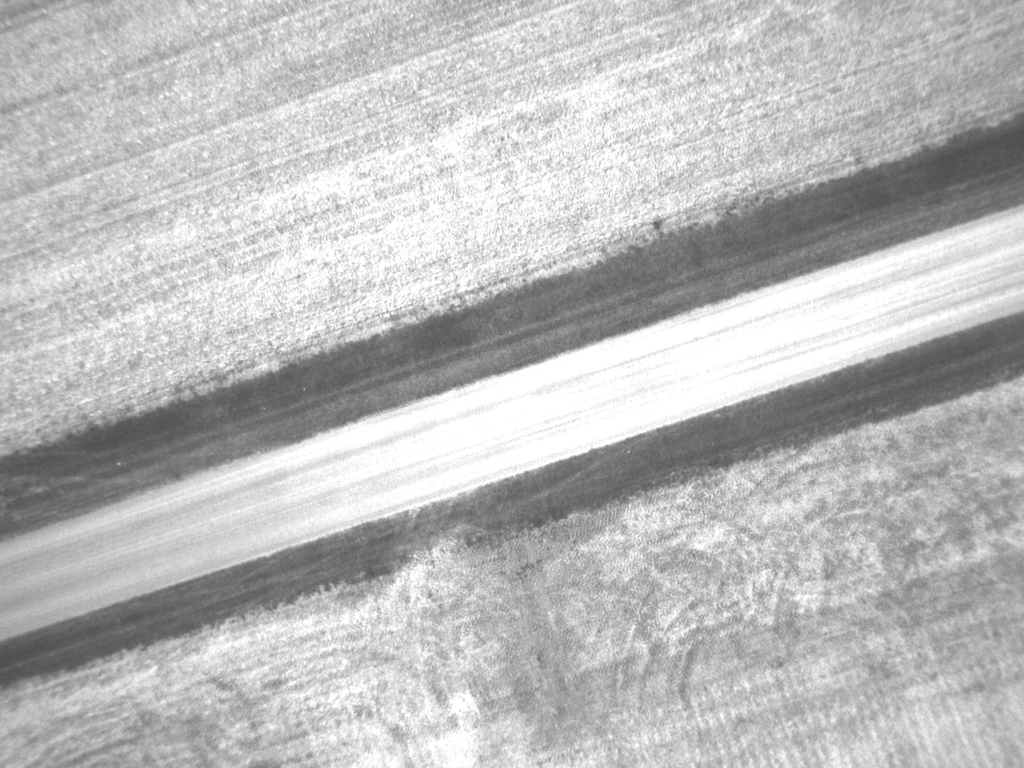
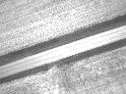
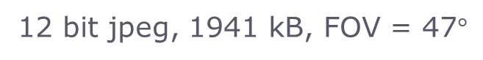
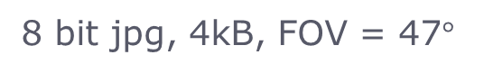
Communications Systems
Thumbnail generation:
Bit depth: 12 bit → 8 bit jpeg
Reduce number of columns/rows by a factor (0.1)
12 bit jpeg, 1941 kB, FOV = 47$°$
8 bit jpg, 4kB, FOV = 47$°$

Slide 17
Communications Systems
Hardware:
Ukpik 1 Transceiver:
Endurosat Type II UHF transceiver
GMSK + FSK modulation
Data rate: 1.2 kbps - 19.2kbps
Half duplex
Frequency range: 430-440MHz
Output Power: 1W
Noise Figure (LNA + filter insertion loss): 1.5dB

Slide 18
END HERE
This is where the OBC interfacing stuff ends

Slide 19
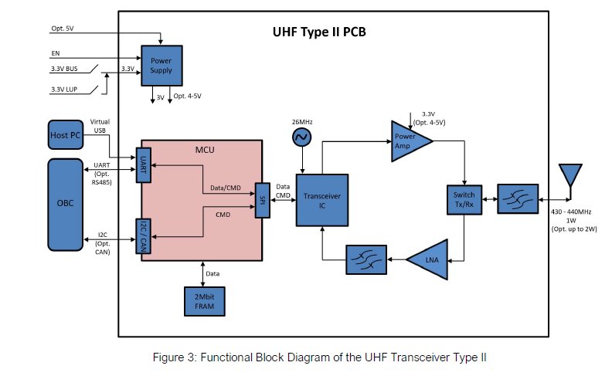
Communications Systems

Slide 20
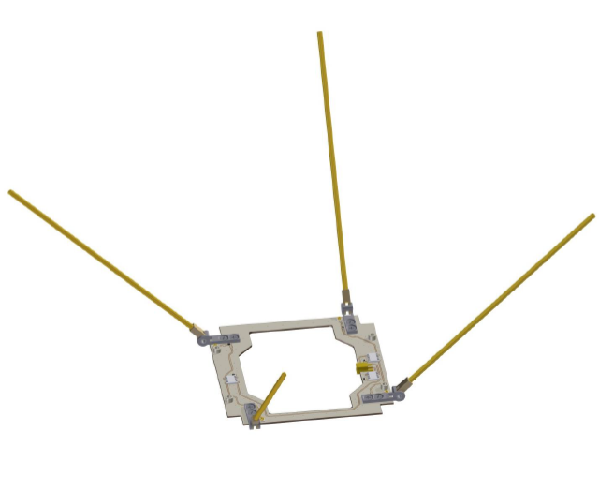
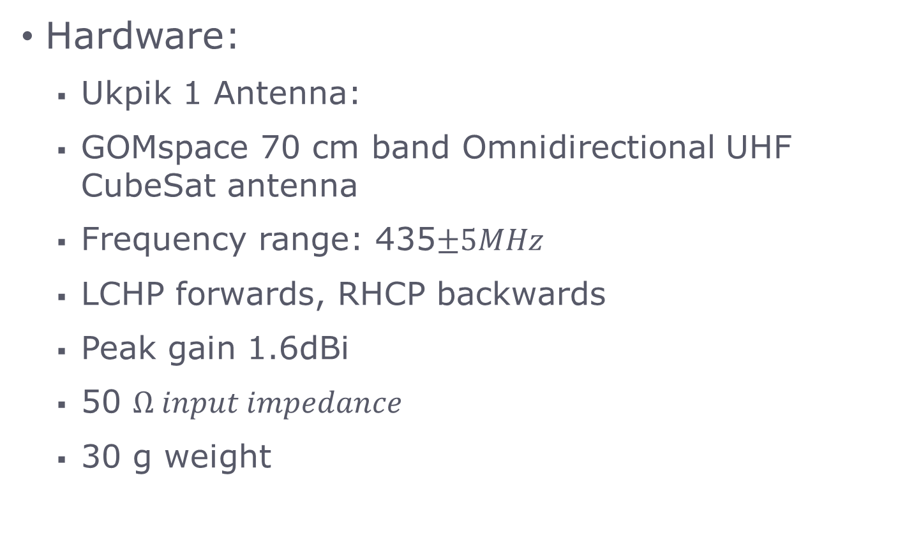
Communication Systems
Hardware:
Ukpik 1 Antenna:
GOMspace 70 cm band Omnidirectional UHF CubeSat antenna
Frequency range: 435$±5MHz$
LCHP forwards, RHCP backwards
Peak gain 1.6dBi
50 $Ω input impedance$
30 g weight

Slide 21
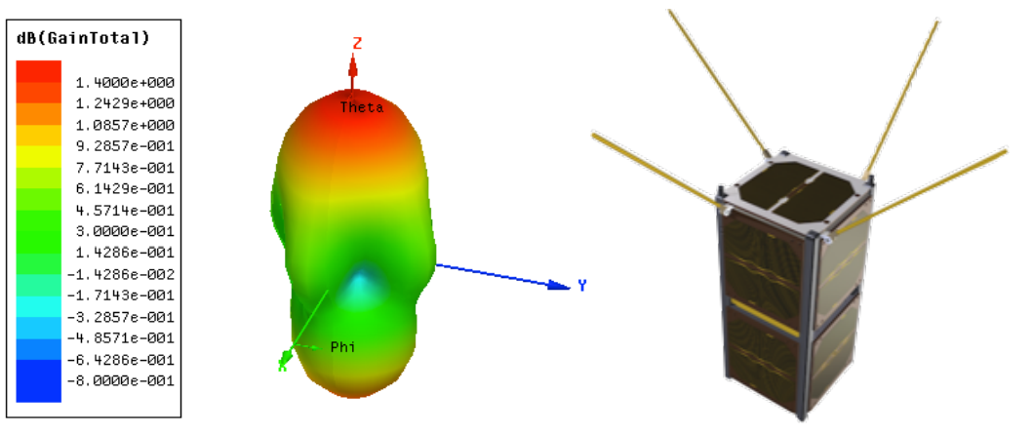
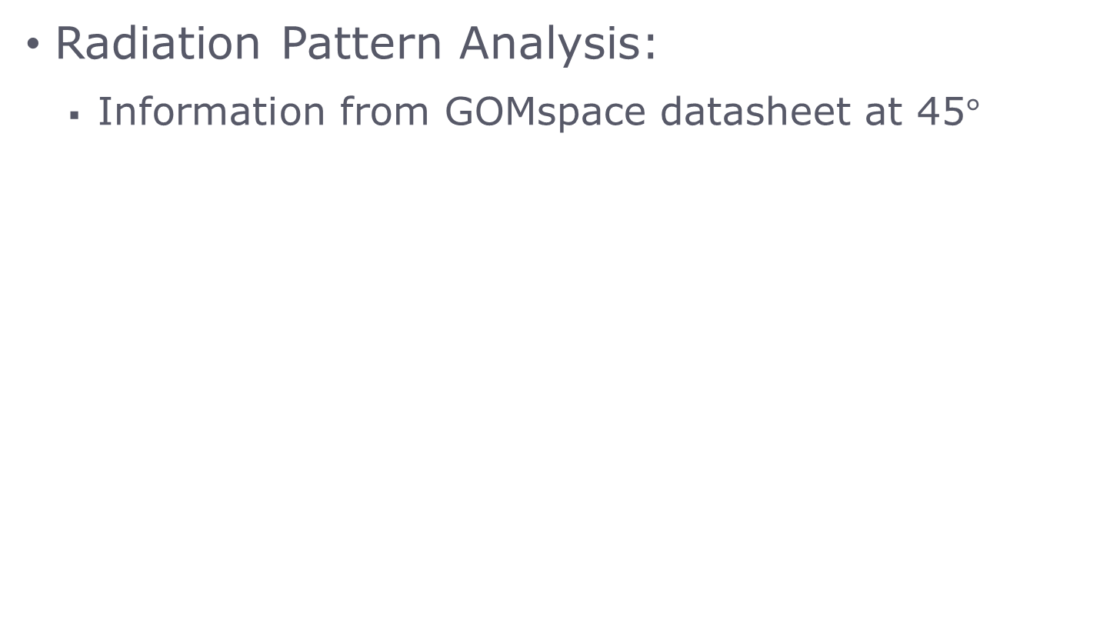
Communication Systems
Radiation Pattern Analysis:
Information from GOMspace datasheet at 45$°$

Slide 22
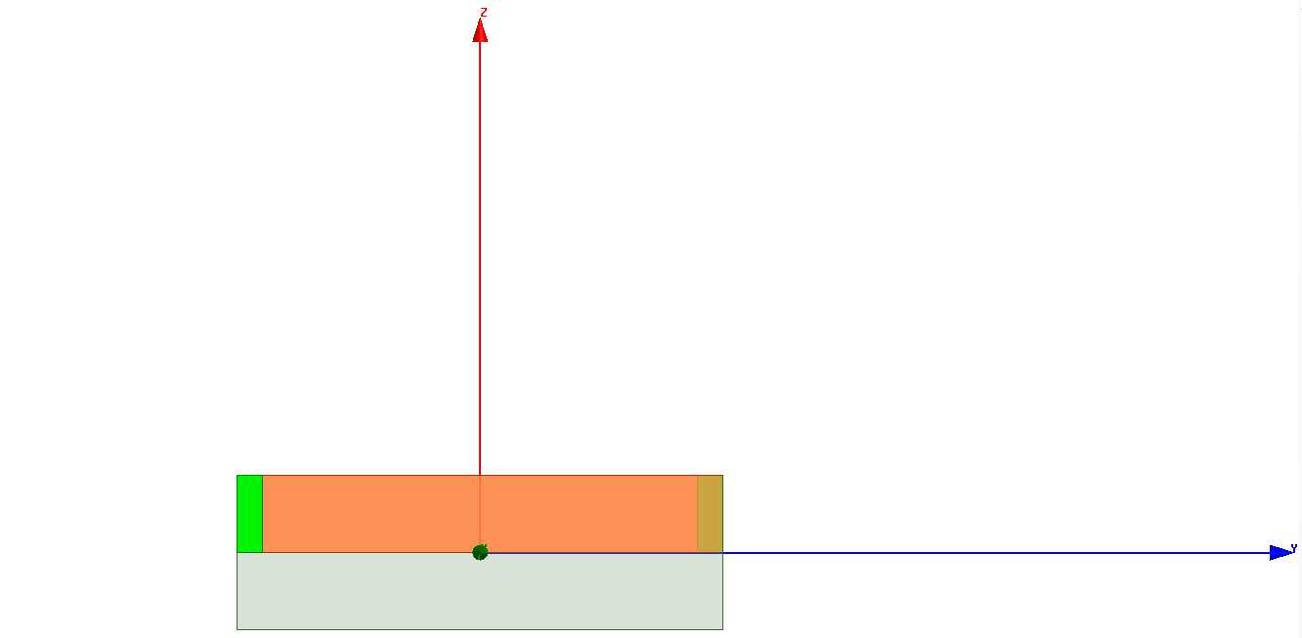
Communication Systems
Work done by Kelsey Doerkson:
Additional information:
Will be referring to monopole orientations in positive angle offsets.
Referencing the substrate below
Datum

Slide 23
Communications Systems
More information:
45 degree offset of my model is more omnidirectional than ANT430 model from GOMspace
The model makes an assumption of using perfect conductors for the monopoles
Next steps: Add in the CubeSat structure to see the effects on the radiation pattern
Bending was not done because it is unrealistic in ANSYS HFSS. Hands on testing more suitable

Slide 24
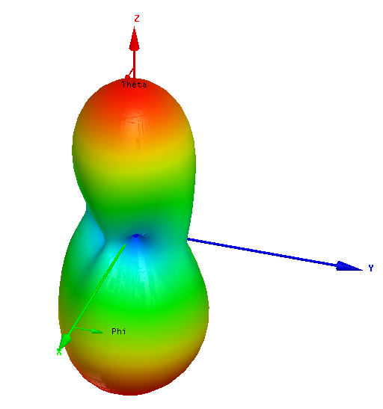
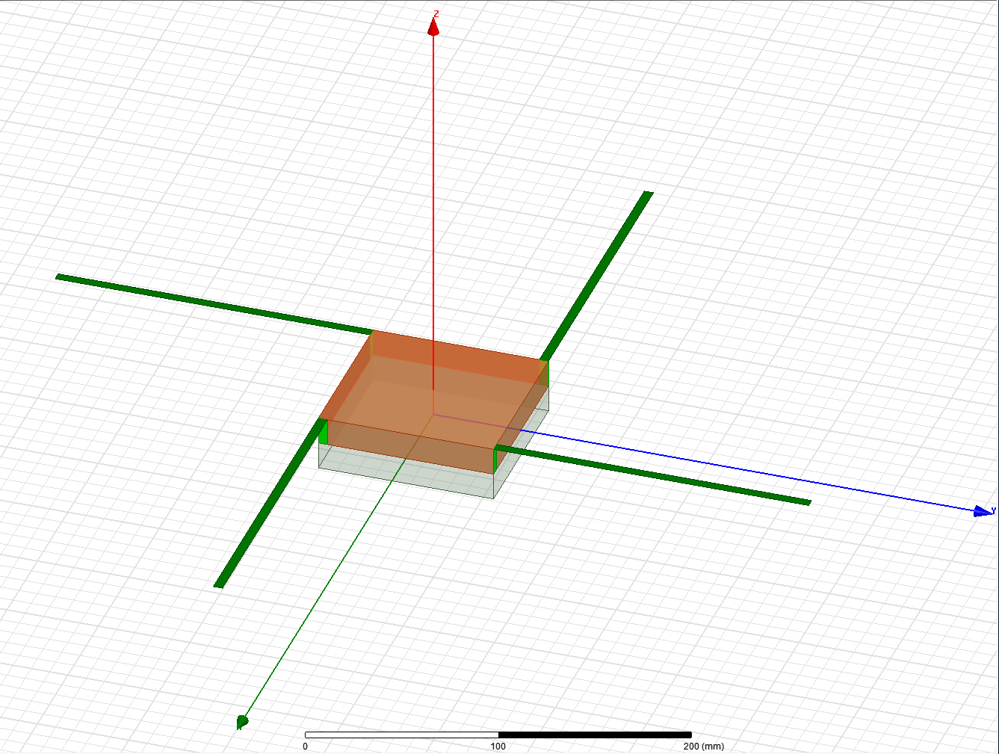
Communications Systems
0 degrees:
Max gain: 3.9 dB
Min gain: -0.006dB

Slide 25
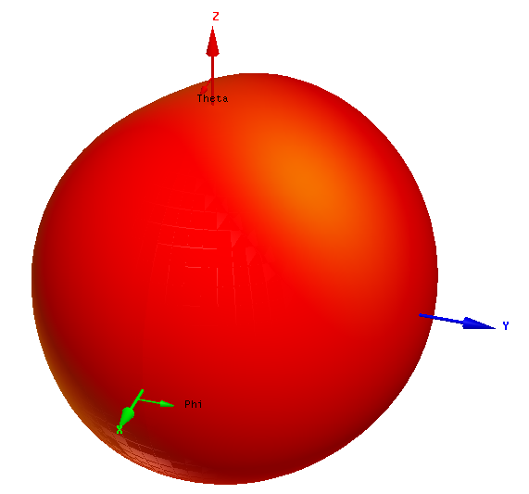
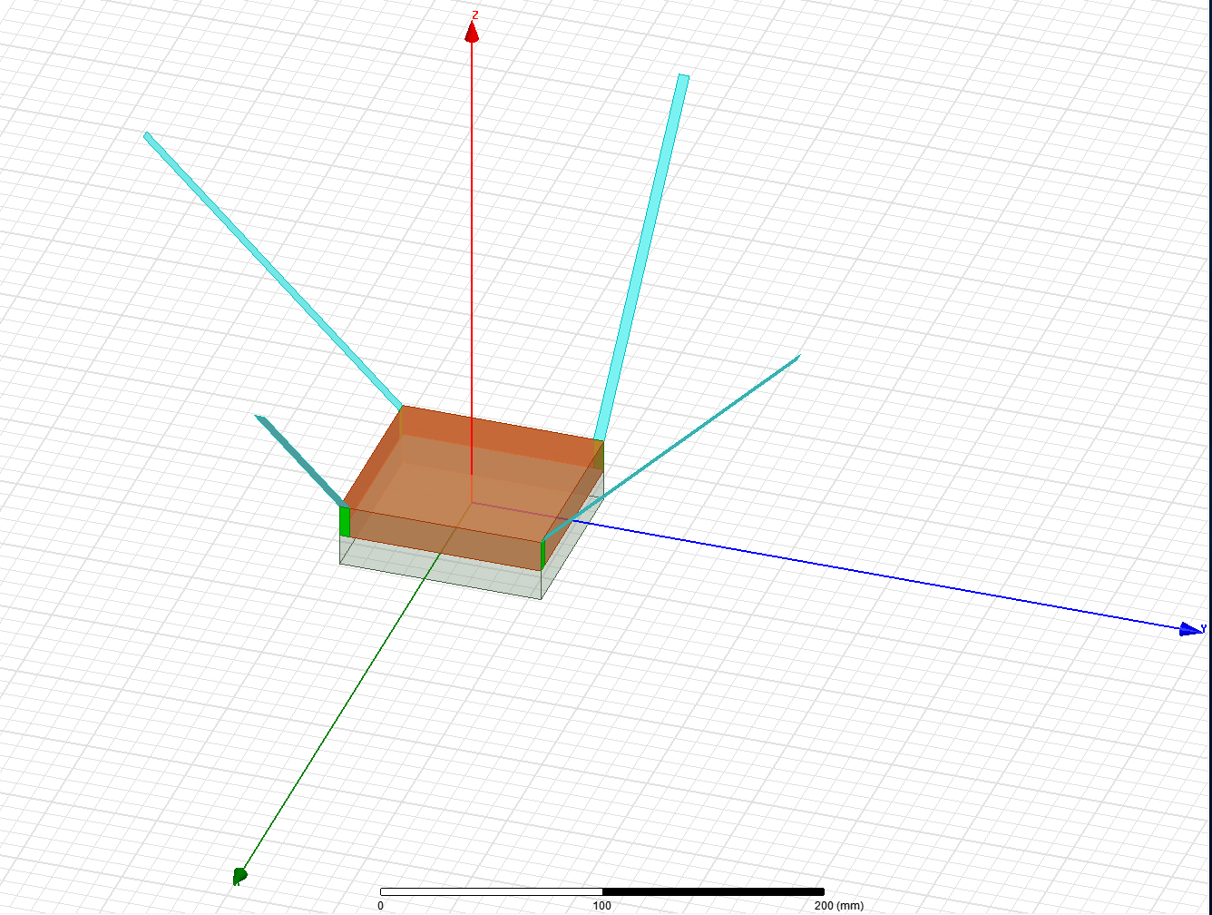
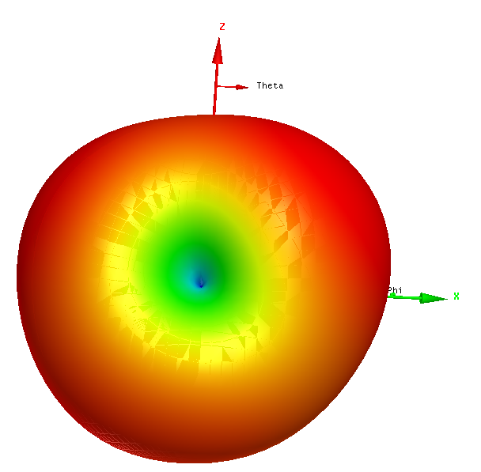
Communications Systems
45 degrees:
Max gain: 2.2 dB
Min gain: -9.05dB

Slide 26
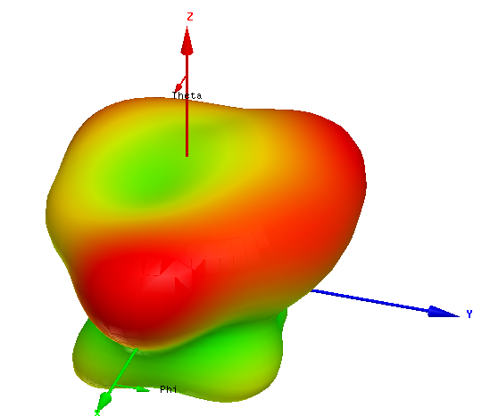
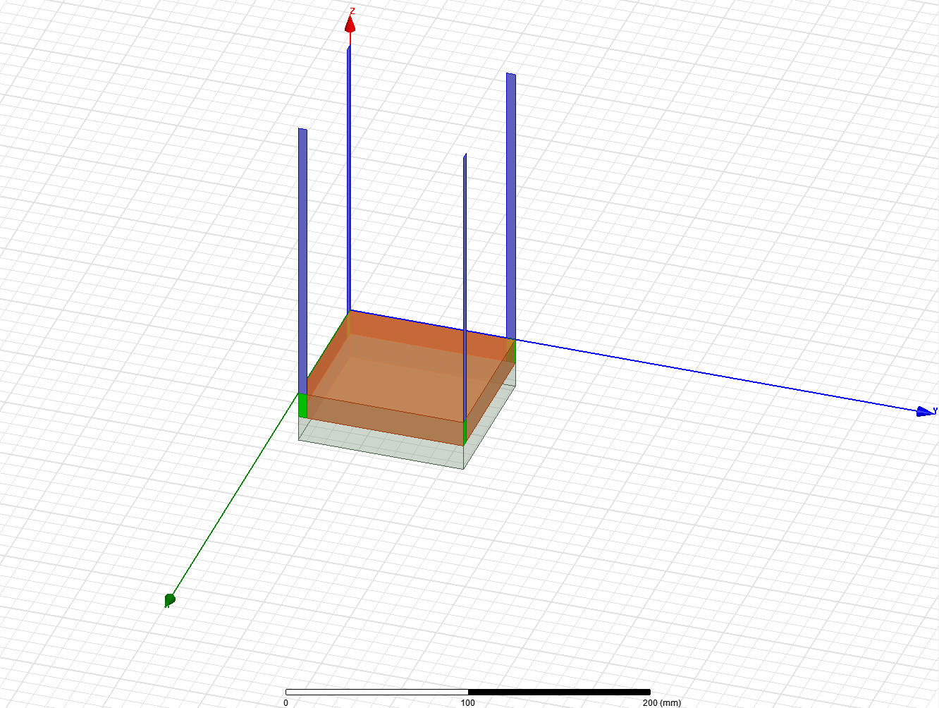
Communications Systems
90 degrees:
Max gain: 0.23dB
Min gain: -0.007dB

Slide 27
Communications Systems
Summary Chart for all monopole offsets simulated:
Monopole Offset (Degrees) | Maximum Gain (dB)
0 | 3.90
10 | 3.37
20 | 3.23
30 | 3.07
40 | 2.89
45 | 2.20
50 | 2.15
60 | 1.69
70 | 1.28
80 | 0.74
90 | 0.23

Slide 28
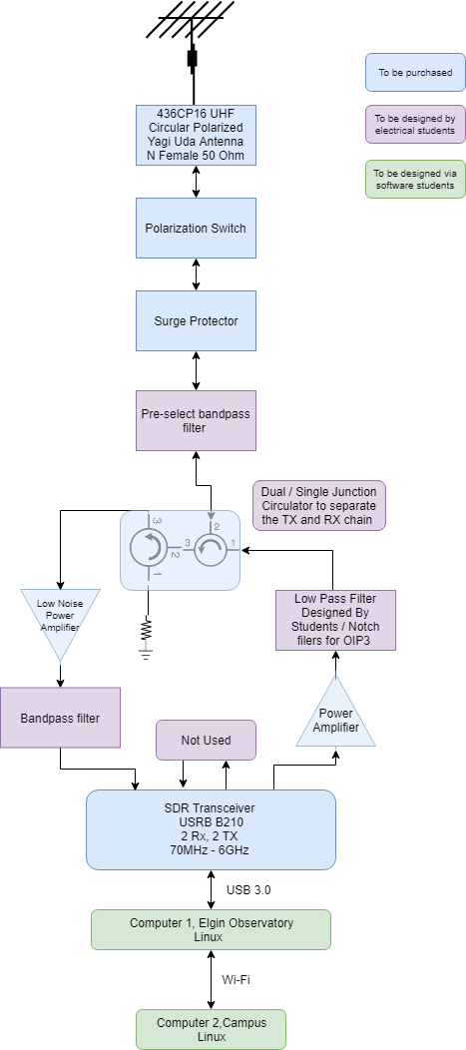
Communication Systems
Groundstation Block Diagram
Important Design Choices still:
Filter design by capstone students
Power amplifier gain
Driven by: Third harmonic Output
SDR transceiver specs.
Etus USRB B210
Link budget Output power need

Slide 29
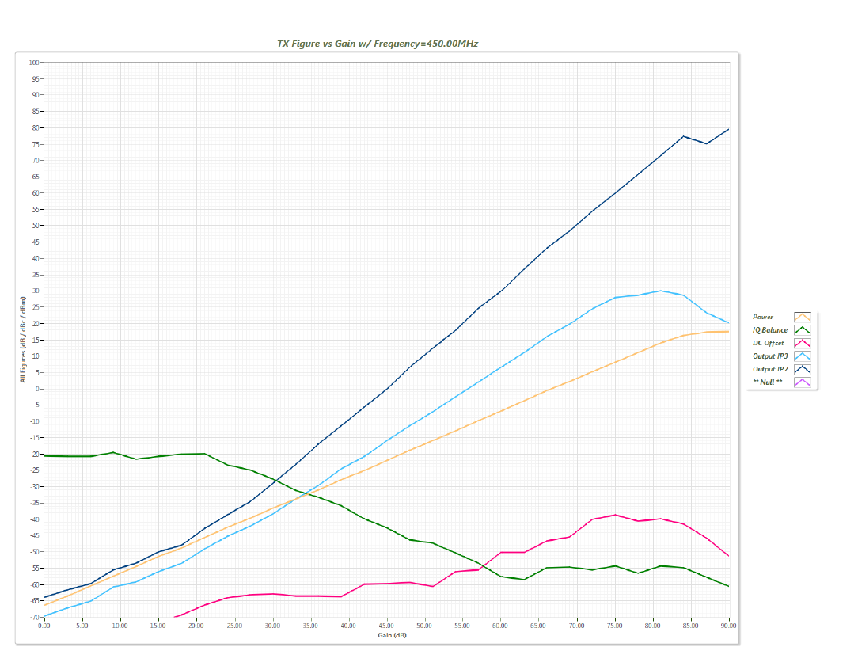
Communication Systems
Tight filtering needed
Moderate filtering needed

Slide 30
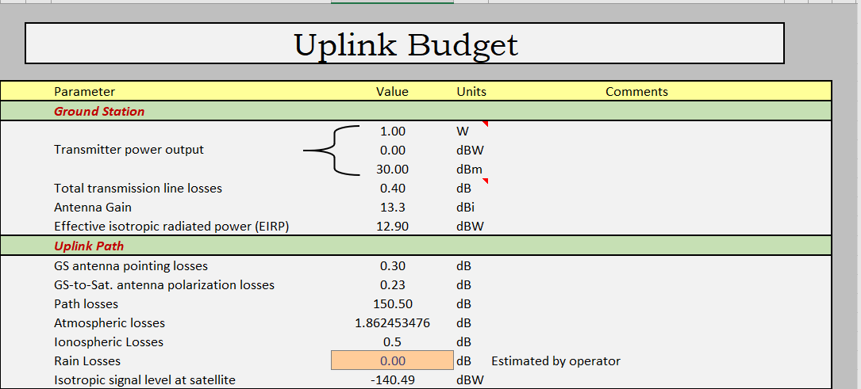
Communication Systems
Link Budget:

Slide 31
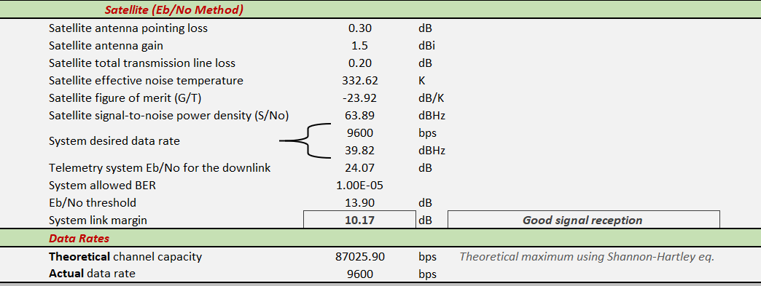
Communication Systems

Slide 32
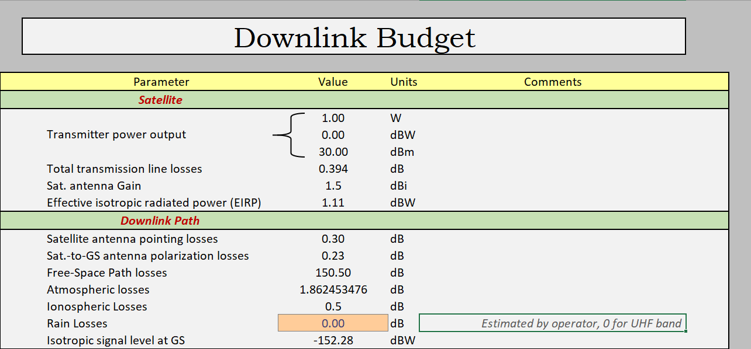
Communication Systems

Slide 33
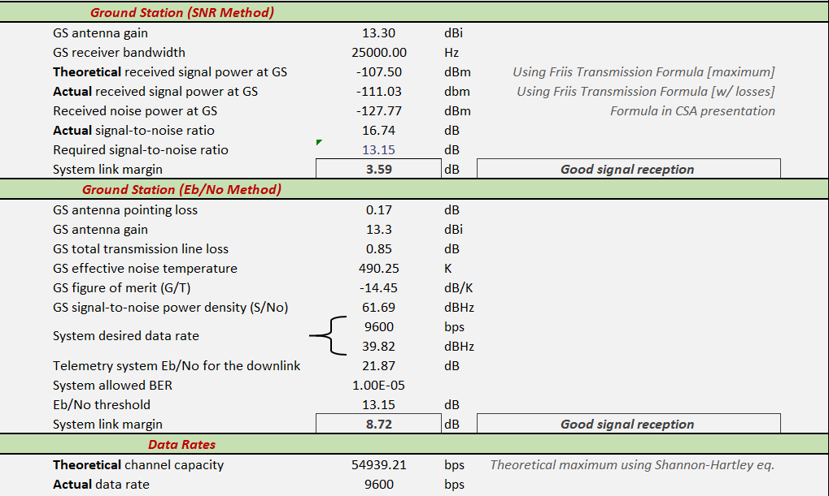
Communication Systems

Slide 34
Communication Systems
Uplink Eb/No method chosen because SNR method has lacking information at this point of time.
Advice from Peter Kazakoff + outlined issues of Link Budget from July 31st 2019.
Separating TX & RX when building ground station block diagram.
Scaled back power from transmitter on earth
Antenna noise temperature
Adjusted CubeSat Noise temperature to gain-weighted average using ITU recommendations.

Slide 35
Communication Systems
Antenna Noise Temperature:
Ground station antenna still needs to be looked at. Conservative value of 530k chosen.
Cable loss was too high before, this has been scaled back to 0.85dB based on LM400 and 9m length.
Filter insertion losses added as an estimate 1 dB was added
Polarization switch was added in case of ADCS failure.

Slide 36
Communication Systems
Frequency Licensing:
Dr. Jayshri Sabarinathan and Nicholas Mitchell will be getting their amateur radio licenses.
Required for RAC endorsement application
Has been started but not completed
Required for IARU satellite coordination request
Has been started but not completed
It is acknowledged that this will be the highest priority once PDR is over.

Slide 37
AIT
~10 slides
Propose a design of the Electric Ground Support Equipment (EGSE);
Propose a design of the flatsat that will aid in the development of flight software and the verification of operations. Flatsat can be used for:
Test and verify all hardware interfaces
Verify all spacecraft modes and state transitions
Test and verify software commands and procedures
Validate Mission Operations commands and procedures
Validate power transmission for operating modes
Test for failure modes and recovery procedures
Validate ground segment protocols and communications functionality
Propose CubeSat test plan including safety and handling procedure
Present the laboratory environment for spacecraft integration and tests

